Slide 1
Model View Controller
By
Bernard Do, Eha Sah

Slide 2
What is MVC?
Design Pattern?
A Language?
A new technology?
Model View Controller
3 Parts

Slide 3
Model
Business flow of an application
Model is responsible to manage our data.
It allow us to structure our data in a reliable way and gets it when controller asks for it

Slide 4
View
Display output to the user
Rendering
View is also known as presentation layer.
Responsible to display the data provided by the model in a specific format

Slide 5
Controller
Controller handles user requests
When client requests a URL from the server, it will match it with the location of the URL. If it cannot find it, then a error 404, Not Found is returned.
It acts a bridge between Model and View

Slide 6
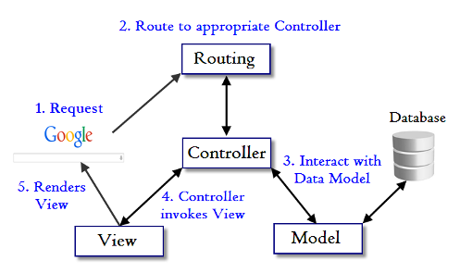
How MVC works

Slide 7
Why MVC?
Faster development process
Ability to provide multiple views
Support for asynchronous technique
Modification does not affect the entire model
MVC model returns data without formatting
Friendly Development platform

Slide 8
Conclusion
Things change very quickly in Software Development environment
Modularity for future developments
Organizations are looking for development of web applications based on MVC architecture for cost and time benefits

Slide 9
Reference
http://www.programminghelp.com/mvc/fundamentals-mvc-framework/
https://developer.mozilla.org/en-US/Apps/Fundamentals/Modern_web_app_architecture/MVC_architecture
https://www.c-sharpcorner.com/article/introduction-to-mvc/

Slide 10
Thank You !

